Slide 1
Analysis of New York from a tourist perspective
Capstone project by Sharadkumar Bhatt (skrbhatt@gmail.com)
Submitted for the assignment: „Capstone Project - The Battle of Neighborhoods”

Slide 2
Introduction / Business Problem
I and my family would like to visit New York
We like to see a few tourist attractions, spend time at the park, look at the exibits in a zoo. We also like to vist historic places of interest.
We have a particular culinary choice – vegetarian
We would also like to stay near the attractions
This is a typical analysis for a group of people who want to visit a new place.

Slide 3
Reasons for choosing New York
The data related to Boroughs and the Latitude and Longitude data is readily available. Also provided in once of the previous assignments.
Hence the data collection part of the project is reduced.
In case of a new city, the following steps will have to be added:
Search for a wikipedia article and scrape the site for neighbourhoods/ boroughs
Collect the longitude / latitude data using geocoder

Slide 4
Data
New York segmented data:
Use the data set available https://cocl.us/new_york_dataset
This contains Boroughs, Neighbourhoods, Latitude and Longitude information

Slide 5
Methodology
Use the FourSquare api to get venue details in each of the above locations
Slice the data into the sections that are required – Attractions / Eating options / stay options
For the simple visualization, bar charts were created using matplotlib

Slide 6
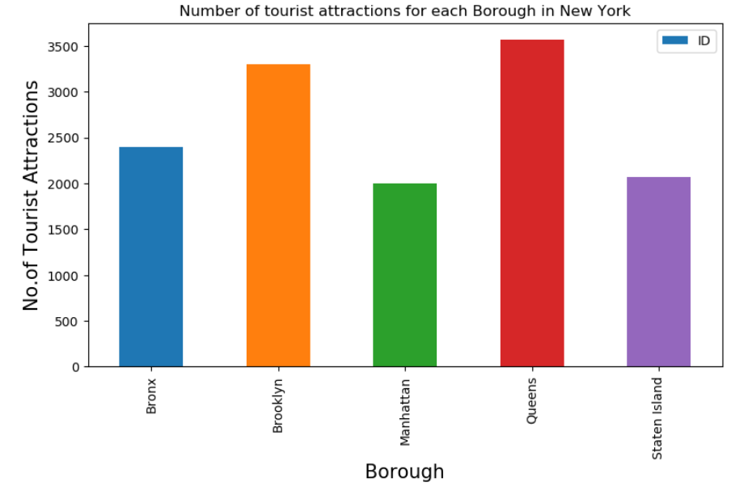
Results: Tourist Attractions

Slide 7
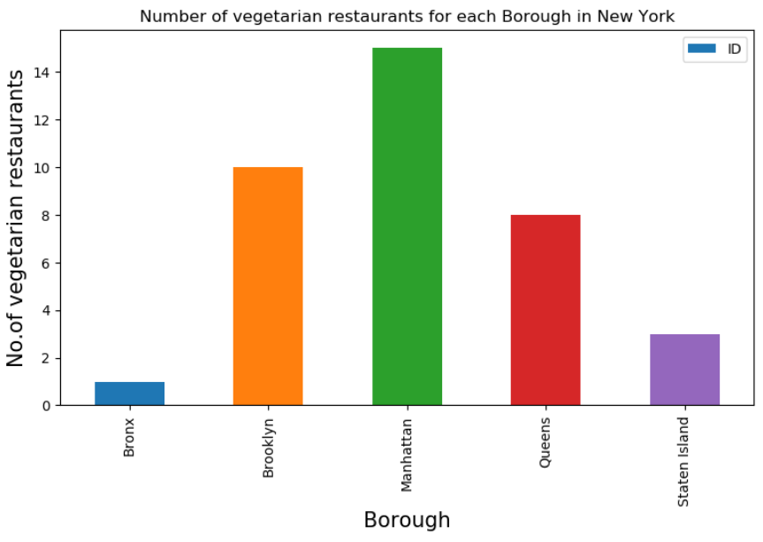
Results: Eating Options

Slide 8
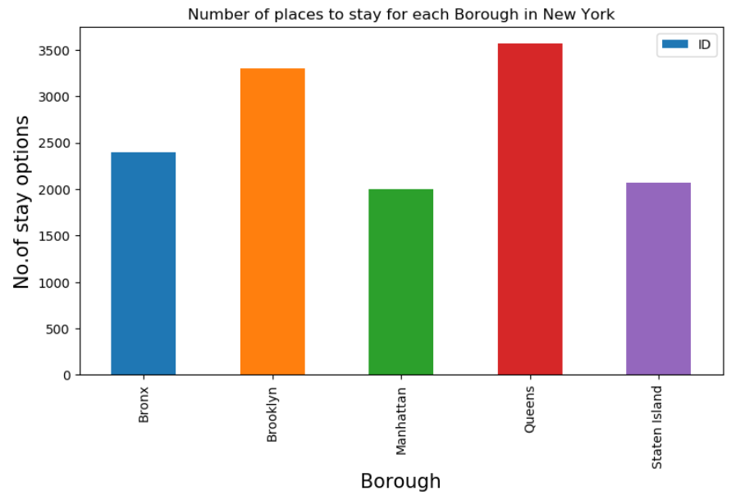
Results: Stay Options

Slide 9
Assumptions
All places are considered equal. The ratings are not used in this analysis. In the future, the ratings can also be used to pin-point the stay / eating / attractions.

Slide 10
Discussion and Conclusion
The maximum number of tourist attractions that interest my family are in Queens and Brooklyn
The maximum number of Vegetarian restaurants are in Manhatten followed by Brookyln and Queens
The stay options are also the best in Queens and Brookyln.
Looking at the map of Newyork, it looks like its easier to go to Manhatten from Queens.
The plan/ recommendation:
Stay in Queens. Use the proximity to major tourist attractions.
For options to eat, Queens has 8 restaurants compared to Brookyln(10) or Manhatten (15). So eat in Queens or go to Manhatten for more options.

Slide 11
Thank you

